Slide 1

SWITCHES HUAWEI
S5732-H48S6Q
S5720-52X-LI-AC
CE8861-4C
CE12808S

Slide 2




Brochure
CloudEngine S5732-H Series Multi-GE Switches
CloudEngine S5732-H series switches are brand-new full-10GE(Multi-GE capable) access switches that provide 24-port and 48-port models, and provide four 25GE and two 40GE ports, or two 100GE uplink ports and one extended slot.
Product Overview
CloudEngine S5732-H series Switches are brand-new full-10GE(Multi-GE capable) switches developed by Huawei for the Wi-Fi 6 era. The CloudEngine S5732-H builds on Huawei's unified Versatile Routing Platform (VRP) and boasts various IDN features. For example, the integrated wireless AC capabilities can manage up to 1,024 wireless APs; the free mobility feature ensures consistent user experience; the VXLAN functionality implements network virtualization; and built-in security probes support abnormal traffic detection, threat analysis even in encrypted traffic, and network-wide threat deception. With these merits, the CloudEngine S5732-H can function as core switches for small-sized campus networks and branches of medium- and large- sized campus networks, and also work as access switches for Metropolitan Area Network. CloudEngine S5732-H can provide a maximum of 48 10GE Multi-GE ports, which is a good choice for WLAN APs to connect to a switch in the high-quality campus networks.
Models and Appearances
The following models are available in the CloudEngine S5732-H series.
Models and Appearances | Description
CloudEngine S5732-H24UM2CC | 24 × 100M/1G/2.5G/5G/10G Base-T Ethernet ports, 4 x 1/10/25GE SFP28 + 2 x 40GE QSFP+ or 2 x 100GE QSFP28 ports One extended slot PoE++ 1+1 power backup Forwarding performance: 490 Mpps Switching capacity*: 1.28 Tbps/2.4 Tbps Note: All ports support GE by default. You can purchase right-to-use (RTU) licenses to upgrade the port rate (every 12 ports per RTU license) from GE to 2.5GE, 5GE, or 10GE.
CloudEngine S5732-H48UM2CC | 48 × 100M/1G/2.5G/5G/10G Base-T Ethernet ports, 4 x 1/10/25GE SFP28 + 2 x 40GE QSFP+ or 2 x 100GE QSFP28 ports One extended slot PoE++ 1+1 power backup Forwarding performance: 490 Mpps Switching capacity*: 1.76 Tbps/2.4 Tbps

Slide 3



Datasheet
S5720-LI Series Simplified Gigabit Ethernet Switches
The S5720-LI series are energy-saving Gigabit Ethernet switches that provide flexible GE access ports and 10GE uplink ports.
Introduction
Building on next-generation, high-performance hardware and the Huawei Versatile Routing Platform (VRP), the S5720-LI series support intelligent stack (iStack), flexible Ethernet networking, and diversified security control. They provide customers with a green, easy-to-manage, easy-to-expand, and cost-effective gigabit to the desktop solution. In addition, Huawei customizes specialized models to meet customer requirements and to suit special scenarios.
The models with front power sockets can be installed in a 300 mm deep cabinet. They can be maintained through the front panel, saving space in small equipment rooms.
The S5720-12TP-LI-AC adopts the ground-free design. Only the 220 V power module needs to be grounded. This design facilitates switch deployment in the places where grounding is difficult, such as corridor.
The models that use a fan-free design reduce power consumption and noise.
Product Overview
Models and Appearances
Appearance | Description
S5720-12TP-LI-AC | 8 10/100/1000Base-T Ethernet ports, 4 GE SFP ports (2 of which are dual- purpose 10/100/1000Base-T or SFP ports) AC power supply Forwarding performance: 18 Mpps Switching capacity: 336 Gbit/s
S5720-12TP-PWR-LI-AC | 8 10/100/1000Base-T Ethernet ports, 4 GE SFP ports (2 of which are dual- purpose 10/100/1000Base-T or SFP ports) AC power supply PoE+ Forwarding performance: 18 Mpps Switching capacity: 336 Gbit/s
S5720-28P-LI-AC | 24 10/100/1000Base-T Ethernet ports, 4 GE SFP ports AC power supply, supporting redundant power supply (RPS) Forwarding performance: 42 Mpps/96 Mpps
S5720-LI Series Simplified Gigabit Ethernet Switches

Slide 4


Data Sheet
Huawei CloudEngine 8800 Switch Datasheet
Huawei CloudEngine 8800 series switches provide high-density 100GE/40GE/25GE/10GE ports and high performance.
www.huawei.com

Slide 5
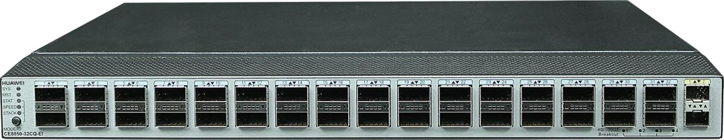
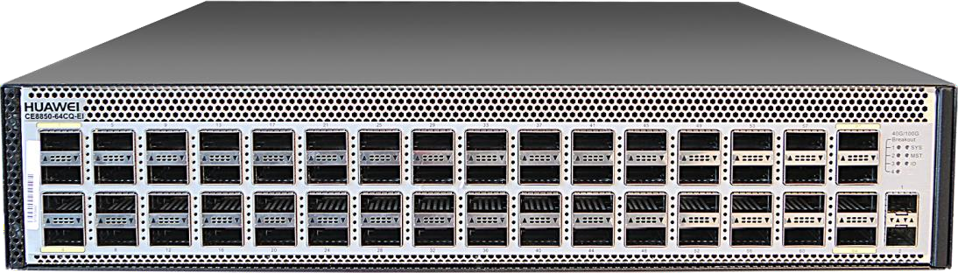
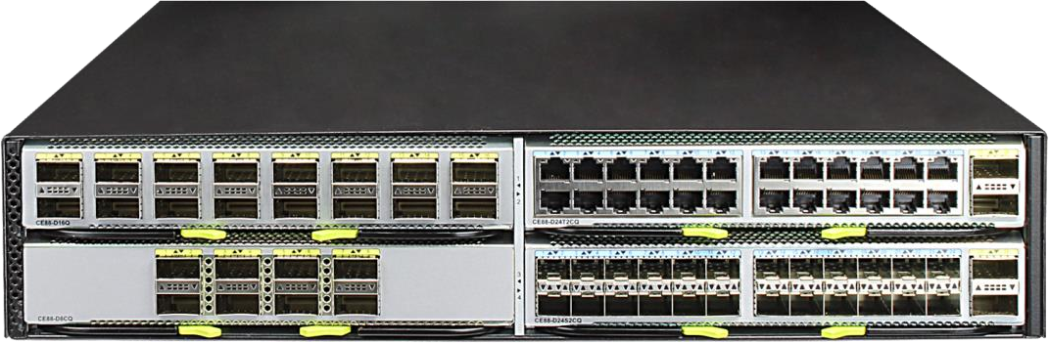
Product Overview
Huawei CloudEngine 8800 series switches are 100G Ethernet switches designed for data centers and high-end campus networks. The switches provide high-performance, high-density 100GE/40GE/25GE/10GE ports, and low latency. Using the Huawei VRP8 software platform, CloudEngine 8800 series switches provide extensive data center service features and high stacking capability. In addition, the airflow direction (front-to-back or back-to-front) can be changed. CloudEngine 8800 series switches can work with CloudEngine 16800/CloudEngine 12800/CloudEngine 8800/CloudEngine 6800/CloudEngine 5800 switches to build an elastic, virtualized, high-quality fabric that meets the requirements of cloud-computing data centers.
CloudEngine 8800 series switches can function as core or aggregation switches on data center networks to help enterprises and carriers build a scalable data center network platform in the cloud computing era. They can also be used as aggregation or core switches for enterprise campus networks.
Product Appearance
CloudEngine 8850-32CQ-EI provides 32*100GE QSFP28 ports and 2*10GE SFP+ ports.
CloudEngine 8850-64CQ-EI provides 64*100GE QSFP28 ports.
CloudEngine 8861-4C-EI supports four flexible cards of half the standard width.
The CloudEngine 8800 series switches support the following models of cards.
CE88-D24S2CQ card: 24*10GE/25GE (SFP28) and 2*100GE (QSFP28)

Slide 6
Datasheet
Huawei CloudEngine 12800 Switch Datasheet
Huawei CloudEngine 12800 series switches use an advanced hardware architecture design, providing as much as 178Tbit/s (scalable to 1032 Tbps) switching capacity and has up to 576*100GE, 576*40GE, 2,304*25GE, or 2,304*10GE line-rate ports.
Using Huawei's VRP8 software platform, CloudEngine 12800 series switches provide stable, reliable, and secure high- performance L2/L3 switching capabilities to help build an elastic, virtualized, and high-quality network.
www.huawei.com

Slide 7
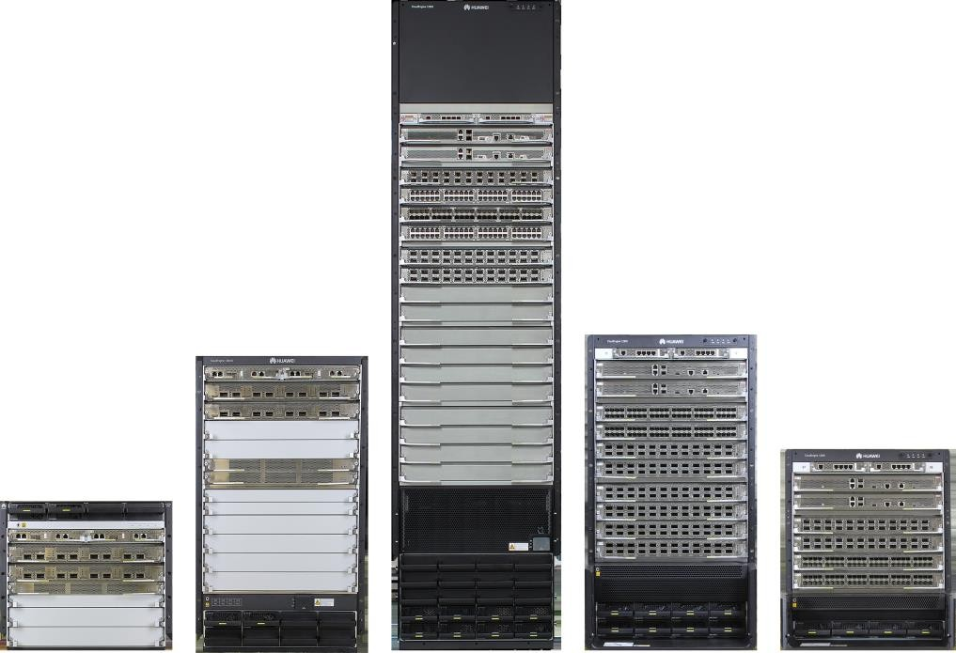
Product Overview
The CloudEngine 12800 series switches are next-generation, high-performance core switches designed for data center networks and high-end campus networks. Using Huawei’s next-generation VRP8 software platform, CloudEngine 12800 series switches provide stable, reliable, and secure high-performance L2/L3 switching capabilities to help build an elastic, virtualized, and high-quality network.
The CloudEngine 12800 series switches use an advanced hardware architecture design. The CloudEngine 12800 series provides as much as 178 Tbps (scalable to 1032 Tbps) switching capacity and has up to 576*100GE, 576*40GE, 2,304*25GE, or 2,304*10GE line-rate ports.
The CloudEngine 12800 series switches use an industry-leading Clos architecture and provide industrial-grade reliability. The switches support comprehensive virtualization capabilities along with data center service features. Their front-to-back airflow design suits data center equipment rooms, and the innovative energy conservation technologies greatly reduce power consumption.
Product Appearance
The CloudEngine 12800 series is available in five models: CloudEngine 12816, CloudEngine 12808S and CloudEngine 12804S.
CloudEngine 12808, CloudEngine 12804,
Platform Chassis
The CloudEngine 12800 series is available in six models: CloudEngine 12816, CloudEngine 12808S, and CloudEngine 12804S.
CloudEngine 12808, CloudEngine 12804,
CloudEngine 12804: 4-Slot Chassis

